Slide 1
NOW EVERYONE CAN SPEAK

Slide 2
Conversation
Discussion
Presentation

Slide 3
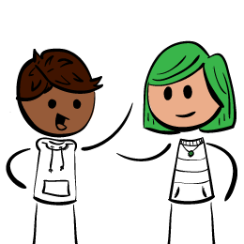

Slide 4
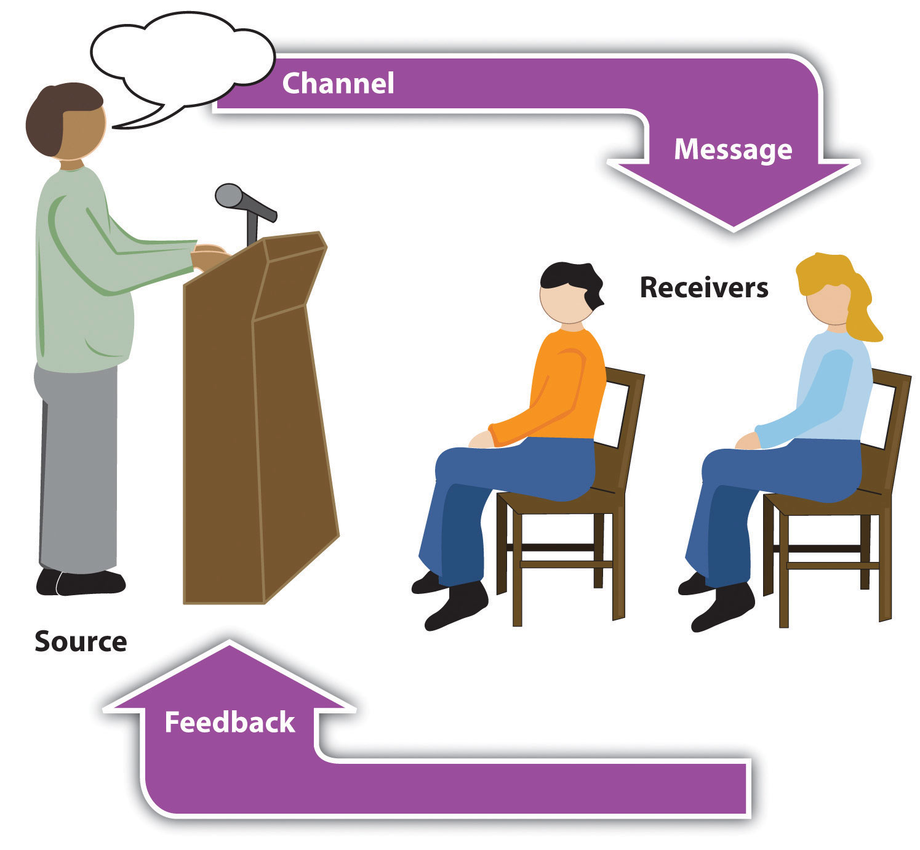

Slide 5
GLOSSOPHOBIA
Glossophobia or speech anxiety is the fear of public speaking.
^{[1]} glossophobia derives from Greek , meaning tongue, phobos, fear or dread.

Slide 6
HOW TO OVERCOME GLOSSOPHOBIA?
Be prepared
Be real
Be vulnerable
Be present
Be generous
https://hbr.org/2016/11/assessment-whats-feeding-your-fear-of-public-speaking

Slide 7
LET’S SIT BACK AND THINK
Think of the things you do during a speech, or a brief introduction, in an effort to feel less afraid. What do you do in an effort to control your fear of public speaking?
Take two minutes. Write down all the responses you can think of.

Slide 8
SOME OF THE ANSWERS
* Read it
* Don't look at audience
* Rush through it
* Skip portions of my talk
* Tell myself it'll be over soon
* Imagine audience in their underwear
* Cough, pretend to have a sore throat
* Use a lot of slides
* Clench fists beneath lectern
* Keep swallowing, to make sure I can drink fluids
* Let a colleague do most of the talking
* Wear my lucky shirt

Slide 9
MOST COMMON ANSWERS
* End the speech as soon as possible
* Avoid any pauses or interruptions during the speech
* Avoid contact with the audience
* Hide the fact that they are afraid

Slide 10
Practice, practice, practice.
Know your material.
Mingle beforehand.
Use calming techniques.
* smile
* breathe

Slide 11
TESTING..TESTING
Prepare and deliver a brief introduction about yourself.

Slide 12
WHAT IS PUBLIC SPEAKING?
Public speaking (also called oratory or oration) is the process or act of performing a speech to a live audience.
Public speaking is the process of communicating information to an audience.

Slide 13
PUBLIC SPEAKING
Who (source)
What (Message itself)
Whom (Audience)
Effect (Intent)
Medium (Actual delivery method)

Slide 14
WHY DELIVER PUBLIC SPEECHES?
To:
* inform
* persuade
* entertain

Slide 15
MAKING POWERFUL AND POSITIVE SPEECHES
Speak with an intent to move people to action
Start strong with a “grabber”
Structure your material in three sections
Practice. Practice.
Know the audience
Know the setup (venue)
Relax

Slide 16
Start strong with a “grabber”
A personal story, a quote from an expert or a shocking statistic – something that takes a hold of your audience and gets them hooked and opens their mind to your message.
Establish credibility. Why are you the best person to talk about this topic?

Slide 17
Speak with an intent to move people to action
Know what you want your audience to do immediately after hearing your speech.
You want your audience to be more informed about the topic presented? Willing to give up smoking?
If there is no reaction, then your objective is not met.

Slide 18
Structure your material in three sections
Grabber/introduction, middle, close.
Know your material.
Get really interested in the topic.
Find good stories.

Slide 19
Practice. Practice
Rehearse out loud with all equipment you plan on using.
Work to control filler words (errr…mmmm…);
Practice, pause and breathe.
Use a clock to check your timings and allow time for the unexpected.

Slide 20
Know the audience
A simple audience analysis
-who will listen to your speech
-where are they from
-what do they do etc.

Slide 21
Know the setup/venue.
Arrive early to check out the speaking area
Practice using the microphone and any visual aids

Slide 22
Relax
Begin with a well prepared grabber.
A relevant personal story is a great start.
It establishes your credibility.
It connects you to the audience and creates the right emotional atmosphere (and calms your nerves).

Slide 23
TYPES OF SPEECHES
Special Occasion speeches
Informative speech
Persuasive speech

Slide 24
SPECIAL OCCASION SPEECHES
Welcoming
Farewell
Acceptance
Introductory

Slide 25
Introductory speech

Slide 27
Presentation Speech

Slide 28
Presentation Speech

Slide 29
Acceptance Speech

Slide 30
Welcoming Speech
To welcome someone- a new colleague etc.
Start with a greeting
Briefly introduce the new person
Express how happy you are to have him/her
Express hopes/expectations etc.

Slide 31
Farewell Speech
Start with a greeting
Thank the people who organized the farewell do
Choose what you wish to say-summarise your experience working at that office
Insert anecdotes (stories)
Recall good memories
Thank everyone

Slide 32
Practice. Practice
Prepare the special occasion speeches given.
You have 5 minutes to prepare.
Your speech should not exceed 3 minutes.

Slide 33
LET’S GET STARTED
Choose a topic
What is your purpose?
Who is your audience?
Where and when will you deliver your speech?
What materials are needed?
Do you need audio visual aids?
How to introduce the topic?
How to conclude the speech?

Slide 34
TOPIC
Must be something that you know about/interested in etc
Relevant to audience

Slide 35
PURPOSE
To
-inform
E.g. The effects of caffeine on your heart.
-persuade
E.g. Coffee should be banned from university cafes.
-entertain
E.g. How I Got My Nickname

Slide 36
AUDIENCE
Who?
What?
Where?
Why?
Which?

Slide 37
DATE/TIME AND VENUE
When
Where

Slide 38
MATERIALS
How much?
How long?
How difficult –content and language?
How to present?

Slide 39
AUDIO VISUAL AIDS
Power point?
Posters?
Pictures?
Live models?
How many?

Slide 40
INTRODUCTION/ATTENTION GRABBER
Start with –
- a story
-statistic/fact
-rhetorical questions
-Illustration
-Quotation

Slide 41
CONCLUSION
Effective endings
To be truly effective, take questions and then finish with a closing that is as powerful as the beginning of your presentation.
A quote
A call to action
A compelling story
Rhetorical question

Slide 42
IMPRESSING YOUR AUDIENCE
Speaker’s image
Delivery style
Language
Audio Visual Aid
Body language

Slide 43
Speaker’s image
Dress appropriately
Be prepared
Brief but effective introduction

Slide 44
Delivery style
Manuscript Style
- The speech is written and the speaker reads it word for word to the audience.
Memorized Style
Impromptu Style
- “made up on the spot.” It is unprepared and unrehearsed
Extemporaneous Style

Slide 45
Language
Clear
Concise
Concrete
Correct
Consistent
Compelling

Slide 46
Language
Pronunciation
-stress
-rhythm
-intonation
Voice
-tone
-pitch

Slide 47
AVA
Clear
Relevant
Useful

Slide 48
Body language/non-verbal communication
Appropriate gestures
Eye contact

