Slide 1
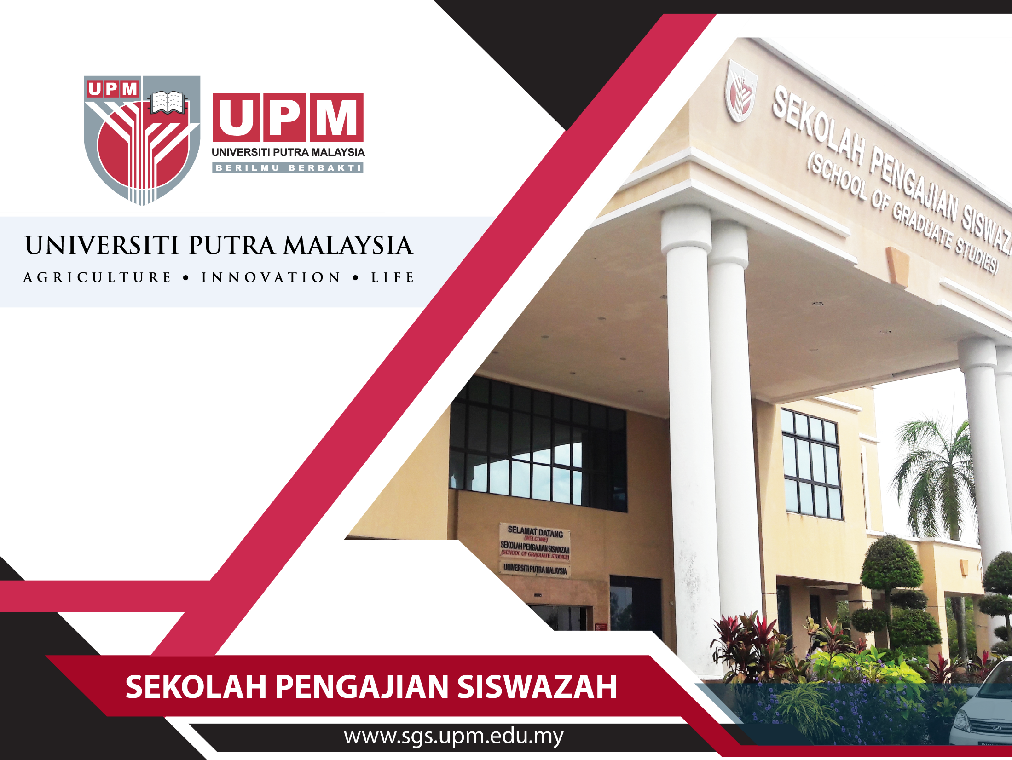
SCHOOL OF GRADUATE STUDIES
(SGS)
SCHOOL OF GRADUATE STUDIES

Slide 2





UPM RANKING
QS World University Rankings 2017/2018 - 229 Among top 1% universities
QS University Rankings Asia 2017/18
QS World University Rankings Top 50 under 50 #17
Agriculture & Forestry (for 5 consectuve years)
Engineering-Chemical
Engineering-Mechamical
Aeronautical & Manufacturing
Modern Languages
Business & Management Studies
Materials Science
Earth & Marine Sciences
Accounting & Finance
Architecture / Built Environment
Engineering — Civil & Structural
Education Pharmacy & Pharmacology
Environmental Sciences
Computer Science & Information System
Engineering-Electrical & Electronics
English Language and Literature
TOP
100
TOP
150
TOP
200

Slide 3

UPM RANKING
Best Universities in Asia
101-150 World's Best Young Universities
Top 75 Most Innovative Universities in ASIA 2016
Best Global Universities US. News Rankings
Top 130 World University Rankings Asia 2017/2018 The Asia University Rankings
UI Green Metric World University Ranking 2015 #17 World # Asia
Other
Achievements :

Slide 4
HISTORY OF
SCHOOL OF GRADUATE STUDIES
The School of Graduate Studies (SGS)
The School of Graduate Studies (SGS) is a service and administrative centre established to assist postgraduate students in the processes involved from their registration at UPM up to the completion of their studies. SGS is the core support system which helps ease and enhance the postgraduate experience for UPM students, and plays a crucial role in fostering the relationship between UPM and its graduates.
Initially set up as a Graduate Study Unit in 1978, SGS then proceeded to become a fully functioning Graduate School Office (GSO) in February 1993, to serve the growing population of postgraduate students at UPM. In March 2002, it continued to flourish as it was officially renamed the School of Graduate Studies (SGS) and was established as a service centre which had a status equivalent to a faculty at the university. This entailed its bigger role in the coordination of all postgraduate programmes and activities at UPM.
In its original inception, its key role also included an active involvement in research and development in postgraduate studies. In other words, SGS was conceptualized not only as a service centre to facilitate the general running of matters related to postgraduate students, but it was deemed to play a more active and crucial role in bolstering UPM’s status as a research university.

Slide 5
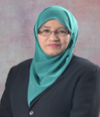
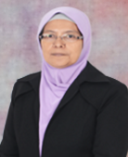
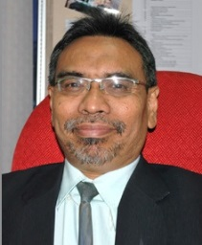

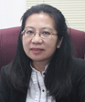
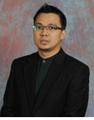
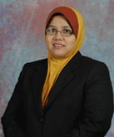
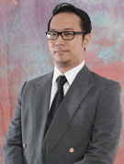
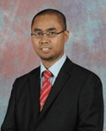
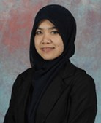
ORGANIZATIONAL
CHART
DEAN
Prof . Dr. Robiah Yunus
dean.sgs@upm.edu.my
ACADEMIC & FINANCIAL AID
THESIS, STUDENT AFFAIRS, LEARNING SUPPORT & PUBLICATION
DEPUTY
DEANS
ADMISSION, INTERNATIONAL AND MOBILITY
DEPUTY
REGISTRAR
Assoc. Prof. Dr. Madya Nor Azowa Ibrahim
norazowa@upm.edu.my
Prof. Dr. Rusli Haji Abdullah
rusli@upm.edu.my
Prof. Dr. Zalilah Mohd Shariff
zalilahms@upm.edu.my
Ms. Zainaf Udin
zainaf@upm.edu.my
OFFICERS
Mr. Nasrul Amri
Selamat
nasrulamri@upm.edu.my
Ms. Maizatul Afzan
Tajul Ariffin
afzan_ariffin@upm.edu.my
Mr. Mohamad Hafiz
Mohamad
mhafizm@upm.edu.my
Mr. Saiful Azlin
Maskan
saiful@upm.edu.my
Ms. Rahmawati Umar
rahwati@upm.edu.my

Slide 6
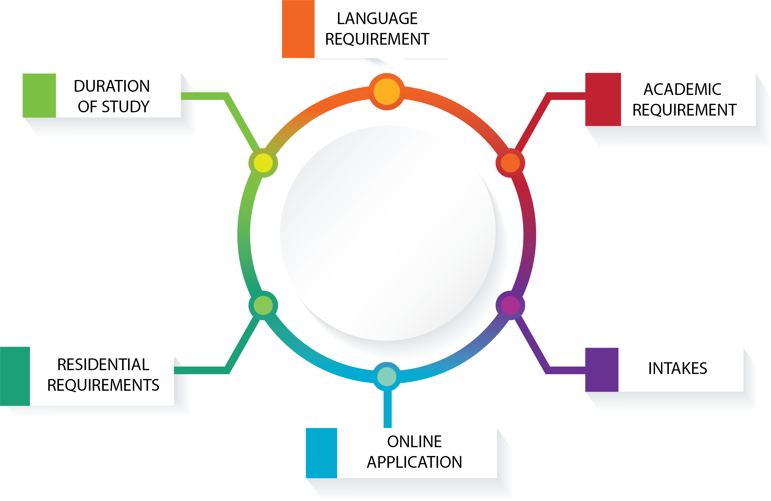






ADMISSION
IELTS, TOEFL-PBT, TOEFL-iBT, CIEP
DOCTORAL DEGREE PROGRAMMES
Full Time: 2 years - 5 years
Part Time: 4 years - 6 years (For local student only)
MASTERS DEGREE PROGRAMMES
Full Time: 1 year - 3 years
Part Time: 2 years - 4 years (For local student only)
CGPA | MASTER | PhD
≥3.00 | √ | √
<3.00 | Subject to any other requirement specified by the Faculty/Institute
ADMISSION
A doctoral student = minimum of 4 semesters / 2 years
A Masters student = minimum of 2 semesters / 1 years
This does not apply to PhD (Industry) students.
SEPTEMBER (FIRST SEMESTER)
FEBRUARY (SECOND SEMESTER)

Slide 7




PROGRAMMES
STRUCTURE
Degree By
Research
Degree by
coursework
PROGRAMME
STRUCTURE
Masters (MS, MA, M.V.Sc.)
Doctor of Philosophy (Ph.D.)
Doctor of Engineering (D.Eng.)
over more than 265 fields of study
Doctor of Public Health (Dr.PH)
Masters (50 programmes)

Slide 8
ACADEMIC

Slide 9
PROGRAMMES
MEDICAL CLUSTER
Faculty of Medicine & Health Sciences
SOCIAL SCIENCE CLUSTER
Faculty of Educational Studies
Faculty of Economics & Management
Faculty of Human Ecology
Faculty of Modern Languages & Communication
Institute of Agricultural & Food Policy Studies
Institute for Social Science Studies
Faculty of Agriculture
Faculty of Biotechnology & Biomolecular Sciences
Faculty of Computer Science &
Information Technology
Faculty of Design & Architecture
Faculty of Engineering
Faculty of Environmental Studies
Faculty of Forestry
Faculty of Food Science & Technology
Faculty of Veterinary Medicine
Faculty of Science
Halal Products Research Institute
Institute of Advanced Technology
Institute of Bioscience
Institute for Mathematical Research
Institute of Tropical Agriculture and Food Security
Institute of Tropical Forestry & Forest Product
Malaysian Research Institute on Ageing
Faculty of Agriculture & Food Science (Bintulu Sarawak Campus)
SCIENCE CLUSTER

Slide 10
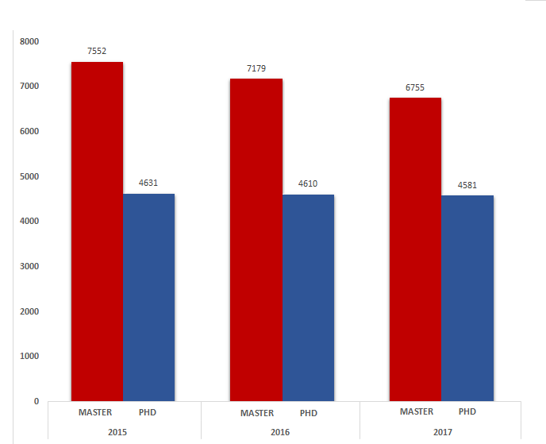
STUDENT ENROLMENT
Student Enrolment for the Year 2015-2017

Slide 11
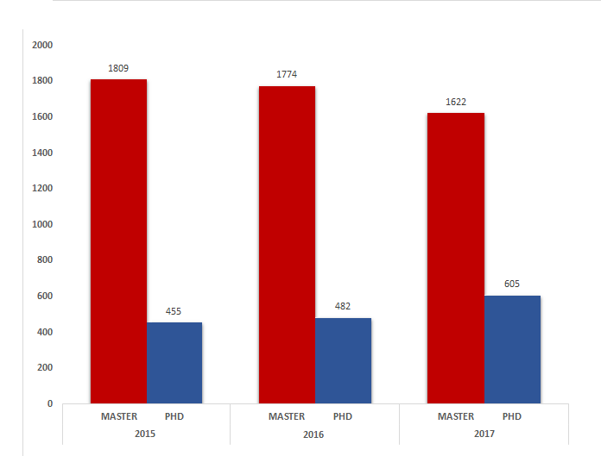
NUMBER OF GRADUATES
Number of Graduates for the Year 2015-2017

Slide 12
MASTER BY
COURSEWORK
Registration of courses week 2 before semester starts
• Add and drop
subject (Before
week 7)
• Change program before
2nd semester
GS17 form (completion/ graduation)
MASTER BY COURSEWORK
Class and Exam
• Class Week
(1 until 14)
• Exam week
(14 until 16)
GS05b (Study
Scheme)
Need to register
total credit
required by
faculty

Slide 13
PHD/MASTER
OF SCIENCE
Doctoral Research SPS6999
Seminar(Research Proposal) SPS6903
> Research Methodology
Registration of courses (2 weeks before semester starts)
Completion/ graduation (GS17 form
Add and drop subject (Before week 7)
Change program or field of study before semester 4
Notice of submission of thesis GS14a form
GS15a to submit the thesis and viva voce
Defer before week 7
Maximum 2 semester
PHD/MASTER OF SCIENCE
Nomination of supervisory committee
Fill GS10a form
> GS11 Online/Doctoral Research
> Start week 4 until week 16 (End of Semester)
Comprehensive Exam (CE) before semester 4 (Only for PhD Programme)

Slide 14



FINANCIAL
ASSISTANCE
GRF
IGRF
Fellowships
FINANCIAL
ASSISTANCE
GRA
SGRA
Assistantships
IGSS
PASS
Scholarship

Slide 15

THESIS EXAMINATION
Categories if Result
1) Distinction – 15 days
2) Minor – 30 days
3) Major – 60 days
4) Re-Submit – 2 semesters
5) Re-Submit as a Masters – 60 days
5) Re-Viva – 60 days
6) Reject
3 Months in Advance
STEP 8
STEP 8
SUBMISSION
OF HARDBOUND FINAL THESIS
STEP 7
THESIS
SUBMISSION
AFTER VIVA
(GS-16a)
STEP 1
NOTICE OF
THESIS SUBMISSION
(GS14a)
Within 3 Months after GS-15a
(Step 4)
STEP 2
STEP 6
THESIS EXAMINATION
NOMINATION
OF EXAMINATION
COMMITTEE
(GS-14b)
FINAL
EXAMINATION
(VIVA VOCE)
STEP 3
STEP 5
APPOINTMENT
OF EXAMINATION
COMMITTEE
THESIS
EXAMINATION
PROCESS
STEP 4
SUBMISSION
OF THESIS
(GS-15a)

Slide 16
UPM
INTERNATIONAL COLLABORATIVE PROGRAMME
(UPM-ICP)

Slide 17
UPM INTERNATIONAL COLLABORATIVE PROGRAMME (UPM-ICP)
DUAL/JOINT DEGREE
Started in 2009.
First Programme : Jointly Awarded Research Degree with The University Of Sheffield.
Total Programme: 27 (with 21 universities)
UK (3), Australia (3), France (3), Japan (1), Canada (1), South Korea (1), Thailand (4), Kazakhstan (2), Iran (1), Jordan (1) and Turkey (1).
Four universities are ranked among Top 100 by QS (Sheffield, Glasgow, Nottingham & Alberta)
37 active students.
6 students have graduated.
A combination of two separate degree.
Involves a joint supervision, if the programme is by research.

Slide 18
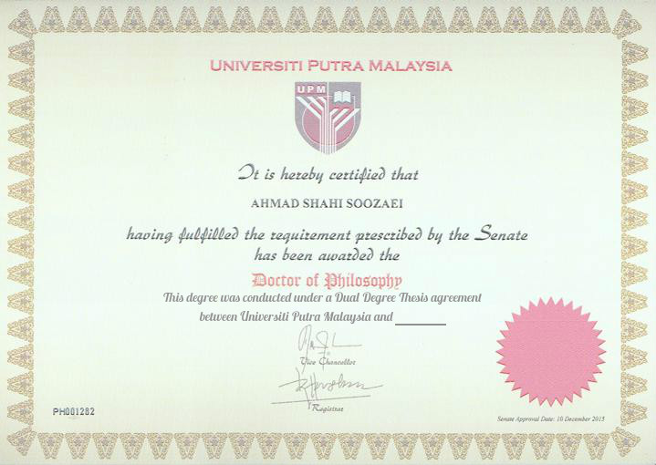
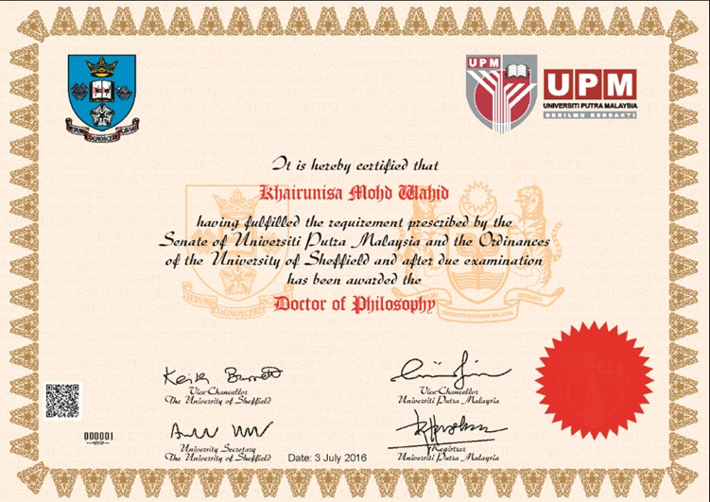
UPM INTERNATIONAL COLLABORATIVE PROGRAMME (UPM-ICP)
DUAL DEGREE
  JOINT DEGREE
Upon completion, the student will be conferred a degree with TWO CERTIFICATES (one from each university).
Each certificate will refer to each other.
  Upon completion, the student will receive a jointly conferred degree (ONE (1) CERTIFICATE with logos of both universities).

Slide 19




UPM-ICP:
PROGRAM OUTLINE
1
English
Requirements
Minimum of Band 6.0/6.5
for IELTS or equivalent
UPM-ICP: PROGRAM OUTLINE
2
Must register as a full-time
student at both institutions
Registration
PROGRAMME | MINIMUM TIME TO BE SPENT AT EACH INSTITUITION
PhD | Min 12 Months
Masters | Min. 6 Months
3
Residential
requirements

Slide 20




UPM-ICP:
THESIS EXAMINATION
English
Language
Only one is required
Thesis
UPM-ICP: THESIS EXAMINATION
Depends on
where the thesis
is submitted
Format
Viva voce
One Examination Committee
and External Examiner

Slide 21
MOBILITY (INBOUND & OUTBOUND)

Slide 22






Attending
Seminar
Research
Attachment/
Coursework
Non-Graduating
programme
Training
INBOUND
MOBILITY
Short Visit
Internship

Slide 23

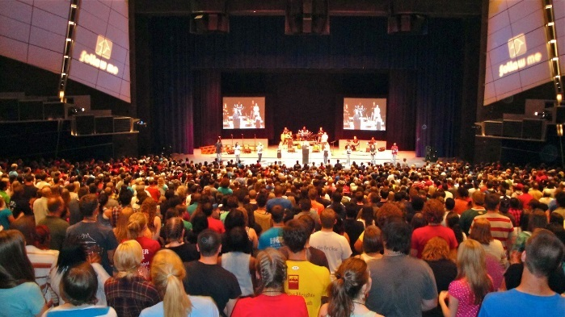
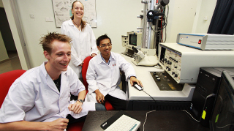
RESEARCH
ATTACHMENT
ABROAD
CONFERENCE
ABROAD
FINANCIAL
AID FOR
OUTBOUND
MOBILITY
PhD students only
Invited as an oral presenter
Local students only
(MS and PhD);
Minimum attachment
period is one (1) month.

Slide 24
FINANCIAL AID
FINANCIAL AID TO ATTEND INTERNATIONAL SEMINAR / CONFERENCE
FINANCIAL AID TO ATTEND RESEARCH ATTACHMENT (OUTBOUND)
Open to LOCAL and INTERNATIONAL students.
Registered as a PhD student.
Current status is “Good Standing”.
Never received assistantship under this scheme.
Not exceeded 7 semesters of study.
Invited as an ORAL PRESENTER.
The presentation related to PhD research work.
Application is submitted at least 30 days before the date of the seminar/conference;
A presentation slides for the seminar is attached when application is submitted (in English / approved by SV).
LOCAL students only.
Registered in Masters (by research) or PhD programme.
Current study status is “Good Standing”.
Length of attachment is between 1-3 months (justification is needed if the duration exceeded three months).
The offer letter from the host institution must be provided when application is submitted to SGS.
Application form (GS-42) can be downloaded from SGS website.
Country | Conference (RM) | Research Attachment (RM)
Southeast Asia (except Singapore and Brunei) | 1,000.00 | 3,000.00
Asia (including Singapore and Brunei) | 1,500.00 | 4,000.00
Other countries | 2,000.00 | 5,000.00

Slide 25
GRADUATION REQUIREMENT

Slide 26

GRADUATION
REQUIREMENT
has settled all fees due to the University.
in the case of a degree programme by coursework, passed all compulsory courses, and project paper or CE, obtained a minimum CGPA of 3.000, and completed the internship/ practical training (if any); and
in the case of a degree by research, passed his thesis examination; and fullfill publication requirements
A student is eligible for conferral of a degree only if he has achieved a minimum CGPA of 3.000, and fulfilled the requirements for courses as certified by the Faculty/Institute/School, and:
a)
b)
c)
  All international students (except for students from Indonesia and Brunei) must have obtained a grade ‘M’ for the Malay Language course (BBM 1401 or its equivalent).

Slide 27
GRADUATION
REQUIREMENT
All students in degree programmes by research must show proof of having published or accepted journal articles based on research conducted during their candidature prior to graduation as follows:
Programme | Minimum Publication Requirement
 | Without GRF | Graduate Research Fellowship (GRF) Recipient
PhD | Two journal articles published or accepted (in CIJ) | GRF | Two journal articles published or accepted (at least one in Q1 or Q2 journal)
 |  | iGRF | Two journal articles published or accepted (in Q1 or Q2 journal)
Master’s | One journal article published or accepted (in CIJ) | GRF | One journal article published or accepted (in JCR)
  A book chapter is considered as being equivalent to one CIJ journal article.
  A student who has filed for a patent based on research conducted during his candidature may apply in writing to the Dean of School of Graduate Studies for exemption. One patent is equivalent to one journal article.

Slide 28
STUDENT AFFAIRS
&
LEARNING SUPPORT

Slide 29

PUTRA SARJANA
ACADEMIC DEVELOPMENT
PROFESSIONAL DEVELOPMENT
Three Minute Thesis (3MT)
University Level
National Level
International Level
Introduction to Teaching
Presentation Skills
etc.
The Basic of Research (22 February 2018)
Element of the Thesis (26 February 2018)
Your Research Journey to GOT
(28 February 2018 – COMPULSORY
for all new postgraduate students)
etc.
PUTRA SARJANA CLUSTERS
A learning support programme designed to develop a wide range
of necessary skills for their
academic and research development
subsequent careers
ETHICS AND MORALS
COMMUNITY SERVICE
Tree Planting
A Day with Rohingya Children
etc.
Human Ethics in Research
Self-Esteem Development
Intercultural Communication (COMPULSORY for all new postgraduate students)
etc.
Students can register for the courses online at the SGS website under activities (http://www.sgs.upm.edu.my)
No registration fee will be charged to UPM students for attending these courses, yet a minimum fee may be charged for workshops.

Slide 30
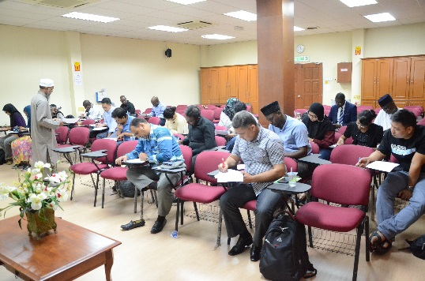
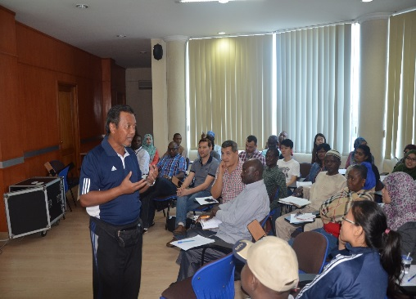
PUTRA GOT
PUTRA GOT PROGRAMME
01
ADVISORY AND STUDENT DEVELOPMENT
02
RESEARCH SKILLS
03
THESIS WRITING AND VIVA VOCE
Ensure Master and PhD students graduate on time
Masters : 4 sem
PhD : 7 or 8 sem

Slide 31




STUDENT AFFAIRS
STUDENT REPRESENTATIVE COUNCIL (MPP)
INTERNATIONAL STUDENT’S ASSOCIATION (UPMISA)
PEER SUPPORT
GROUP (PSG)
COUNTRY REPRESENTATIVE
A special group formed from senior graduate students from various countries to assist postgraduate students to familiarize and adapt to research environment.
Advising and supporting the delivery of effective and efficient student support services.
Advising on the development of academic programmes and student-learning experiences.
To attend to student dissatisfaction and to ensure redress thereof
As a link towards fostering bringing about excellent with regard to student welfare

Slide 32

Terima Kasih | Thank You

