Slide 1
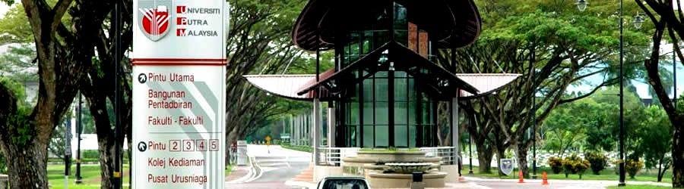

UNIVERSITI PUTRA MALAYSIA
Disediakan oleh:
Sekolah Pengajian Siswazah

Slide 2
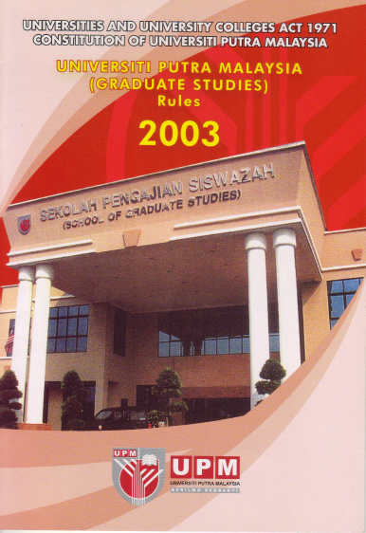


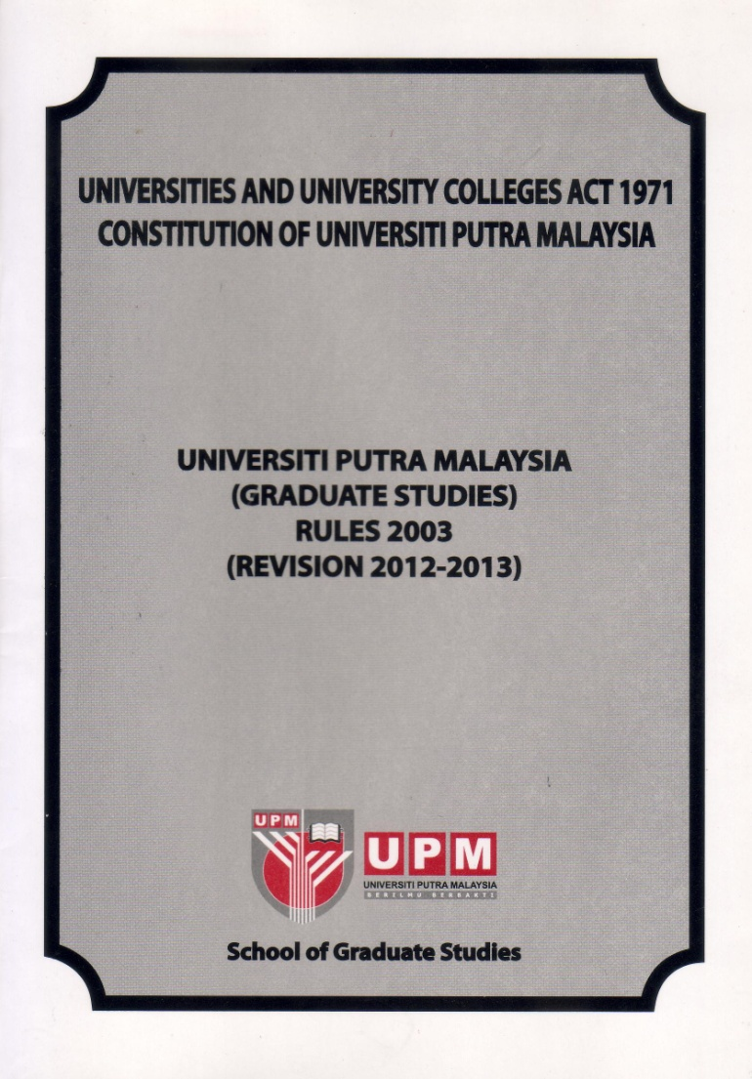
Graduate Studies Rules
Main reference for students and supervisors
Continuously reviewed. Latest edition is available.
Latest Revision 2012-2013. Changes due to some new development in the graduate studies in UPM such
Introduction of new programmes
Changes in programme structure
Incorporation of new rules

Slide 3
Information Management System
Internet Graduate Information Management System
SGS / Student/Staff portal
Real-time interactive system
Secure web-based system
Online Application
Registration
- courses, study scheme
Examination
- marks/grade, progress Report GS11
Application
- transfer, deferment, grade review
Thesis & Viva
- notice of submission, procedure tracking, viva

Slide 4

Who can be a supervisor?
Current Practice on Supervision in UPM
Appointment of Advisor
Appointment of Supervisory Committee
Criteria of Chairman and members of supervisory committee
Restriction of appointment of the committee
Supervisor student ratio
Responsibilities of the supervisory committee (Do’s and Don’ts)
Check list on supervision

Slide 5
Appointment of
Supervisory Committee
Nominate by the student in the first or second semester, on the advice of advisor
MS 2 members, PhD 3 members (min. number incl. chairman)
Chairman and at least one member must be permanent UPM staff
Other member can come from other IPTA or institution which has MOU with UPM
Additional member can be from other institution
Appointment is supported by Faculty/institute and checked by a subcommittee at SGS before approval by UPM Graduate Studies Committee

Slide 6
Criteria of Chairman of Supervisory Committee
Chairman
  Possess PhD or equivalent professional graduate qualification and has experience in graduate supervision. At least has been co supervisor of MS for 1 sem for MS and supervisor for MS for 2 sem for PhD.
  Professor/Associate Professor without PhD but has experience in graduate supervision may be appointed upon senate endorsement.
  A lecturer without PhD but has experience as co supervisor (graduated) may be appointed as chairman for MS.
  Adjunct Professor with PhD and experience in graduate supervision
  Research fellow with PhD and has experience in graduate supervision may be appointed subject to their period of appointment

Slide 7
Supervisor-Student Ratio
Determined by the faculty/institute base on teaching load, lab capacity, research grant, adequacy of facilities.
Recommended ratio:
  Professor 1:10
  Associate Professor 1:7
  Lecturer 1:5
More or less number of students may allowed base on track record. Faculty needs to justify the capabilities of staff.

Slide 8
Checklist on Supervision
The advisor or chairman of the supervisory committee is advised to constantly refer to the checklist issued by the Office of the Deputy Vice Chancellor (PU/S/SS-01) (Checklist for Chairman of Supervisory Committee or Advisor or Programme Coordinator on Semester Registration for Postgraduate Students - http://reg.upm.edu.my/spk_upm/PU-S-web/BORANG-SPS/SS_SPS/PU-S-SS-01.PDF
in carrying out his or her supervisory activities.

Slide 9
Tanggungjawab Penyelia
Pastikan pelajar selian anda:
Mendaftar kursus SPS 5999/6999 setiap semester.
Memilih beban kredit yang sesuai. Fulltime min 9 kredit.
Pastikan pelajar mengisi GS-11 dihujung semester dan penyelia perlu memberi gred M atau TM
Mendaftar seminar proposal pada awal pengajian (SPS5903/6903)

Slide 10
Tanggungjawab Penyelia
Pastikan pelajar mendaftar kursus “Research Method”

Slide 11

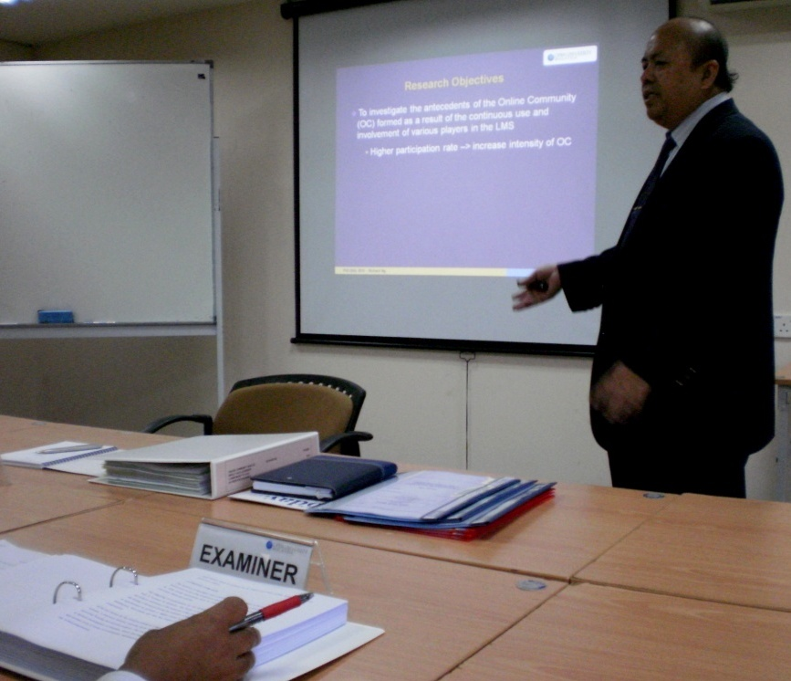
PROGRAM DENGAN TESIS
(PhD & MASTER)
Peperiksaan akhir pengajian bagi pelajar program dengan tesis melibatkan 2 komponen iaitu pemeriksaan tesis dan viva voce.
Borang Notis Penyerahan Tesis (PU/S/BR03/GS-14a) perlu dikemukakan ke SPS 3 bulan sebelum pelajar menyerahkan tesis untuk peperiksaan.
  Pelajar perlu mengisi secara online dan cetak borang.
  Borang perlu mendapat pengesahan drp:
  i) Pengerusi JK Penyeliaan
  ii) Penyelaras PS Fak./Inst.
  Pihak Fakulti/Institut perlu kemukakan cadangan penamaan dlm tempoh 2 bulan ke SPS.
PEPERIKSAAN TESIS & VIVA VOCE
DALAM PENGAJIAN
Permasalahan:
Kenapa pelajar tidak dapat mengisi borang Notis Penyerahan Tesis secara online?
Jawapan:
Pelantikan ahli JK Penyeliaan belum dibuat.
Tidak melengkapkan jumlah keperluan kredit mengikut ketetapan Fakulti/Institut/Penyelia.
Belum menduduki peperiksaan komprehensif (CE) (untuk PhD).

Slide 12
PROGRAM DENGAN TESIS
(PhD & MASTER)
Tindakan di Fakulti/Institut:
kemaskini maklumat penamaan dalam i-GIMS;
cetak borang Penamaan Jawatankuasa
Peperiksaan Tesis (PU/S/BR03/GS-14b);
Dapatkan persetujuan ahli yang hendak dilantik;
Lengkapkan CV Pemeriksa Luar/Felo Penyelidik (lantikan sbg Pemeriksa Dalam); dan
kemukakan borang PU/S/BR03/GS-14b dan
CV pemeriksa ke SPS (pada minggu pertama setiap bulan).
Dokumen Rujukan:
Kaedah UPM (Pengajian Siswazah) 2003
(Semakan 2012-2013)
Garis Panduan Pelantikan Ahli JK Peperiksaan Tesis
PEPERIKSAAN TESIS & VIVA VOCE
DALAM PENGAJIAN

Slide 13
PELANTIKAN AHLI JK PEPERIKSAAN TESIS
PROGRAM DENGAN TESIS
(PhD & MASTER)
Semakan kesesuaian oleh JKKPPPTP (minggu ke-2).
Kelulusan JKPSU (minggu ke-3).
Cetakan surat pelantikan kepada ahli JK Peperiksaan Tesis (selepas kelulusan JKPSU)
Penamaan yang tidak disokong oleh JKKPPPTP / tidak diluluskan oleh JKPSU akan diminta utk disemak semula oleh Fakulti/Institut.

Slide 14
PENYERAHAN TESIS UNTUK PEPERIKSAAN
PROGRAM DENGAN TESIS
(PhD & MASTER)
Borang Penyerahan Tesis untuk Peperiksaan (PU/S/BR03/GS-15a) perlu dikemukakan ke SPS bersama dgn 4 salinan tesis, 4 salinan laporan turnitin dan 1 CD.
Borang perlu mendapat pengesahan drp:
i) ahli JK Penyeliaan
ii) Penyelaras PS Fak./Inst.
Tesis hanya boleh diserahkan ke SPS selepas pelantikan ahli JK Peperiksaan Tesis.
Pelajar berstatus ‘Continue’.

Slide 15
PROSES PEMERIKSAAN TESIS
PROGRAM DENGAN TESIS
(PhD & MASTER)
Penghantaran Tesis kepada ahli JKPPT
Hantar peringatan
Kemaskini maklumat dlm i-GIMS
Terima laporan dlm tempoh 45 hari (PhD)/30 hari (Master).

Slide 16
PEPERIKSAAN AKHIR (VIVA VOCE)
PROGRAM DENGAN TESIS
(PhD & MASTER)
Tetapkan Tarikh Viva Voce
Dibuat selepas terima semua laporan/sekurang-kurangnya 2 laporan termasuk Pemeriksa Luar.
Dptkan Pengesa-han
Dptkan pengesahan tarikh drp ahli JKPPT.
Dibuat melalui emel, telefon @ sms.
Hantar Jempu-tan
Hantar jemputan kpd ahli JKPPT, ahli JK Penyeliaan & pelajar (melalui surat/emel).

Slide 17
KEPUTUSAN VIVA VOCE
PROGRAM DENGAN TESIS
(PhD & MASTER)
Dapatkan laporan drp Pengerusi JKPPT (dlm tempoh 7 hari selepas viva voce).
Edar laporan kpd pelajar, ahli JKPPT, Pengerusi JK Penyeliaan dan Fakulti/Institut.
Keputusan viva voce:
Keputusan | Tempoh | Borang
Distinction Minor Major | 15 hari 30 hari 60 hari | PU/S/BR03/GS-16a

Slide 18
Samb.
PROGRAM DENGAN TESIS
(PhD & MASTER)
Keputusan | Tempoh | Borang
Re-viva voce | 60 hari selepas viva voce pertama | -
Re-submission | 2 semester (perlu mendaftar semula dan menjelaskan yuran penuh) | PU/S/BR03/GS-15b
Re-submission of a PhD Thesis as a Masters Thesis | 60 hari | PU/S/BR03/GS-15b
Fail | - | -
Permohonan pelanjutan tempoh penghantaran tesis boleh dibuat kpd Dekan SPS melalui sokongan Pengerusi JK Penyeliaan. Kegagalan mengemukakan tesis dalam tempoh yg ditetapkan akan mengakibatkan tesis ditolak dan status pengajian pelajar ditamatkan.
Publication of “ Graduate Times “

Slide 19
PENERIMAAN TESIS SELEPAS VIVA VOCE
PROGRAM DENGAN TESIS
(PhD & MASTER)
SPS menerima borang Penyerahan Tesis Selepas Peperiksaan Akhir (PU/S/BR03/GS-16a) drp pelajar. Borang perlu disahkan oleh Pengerusi JK Penyeliaan, 2 Pemeriksa (PhD)/1 Pemeriksa (Master), Pengerusi JKPPT & Penyelaras PS.
Sediakan senarai utk kelulusan JKPSU.
Sediakan senarai utk semakan JK Kecil Semakan Tajuk Tesis (JKKSTT).
Sediakan senarai utk pengesahan Senat Universiti.

Slide 20
PENERIMAAN TESIS MUKTAMAD
PROGRAM DENGAN TESIS
(PhD & MASTER)
Terima borang PU/S/BR03/GS-16b, tesis berjilid kulit keras & CD drp pelajar (selepas disahkan Senat Universiti).
Pelajar mengemukakan salinan tesis yg tlh lengkap kpd setiap ahli JK Penyeliaan.
Salinan tesis dan CD dihantar ke Perpustakaan dan Fakulti/Institut untuk simpanan.

Slide 21
Khurasan Institute of Higher Education Bakhtar University University of Wollongong The University of Melbourne (UMEL) University of Kufa The University of Otago, Dunedin Northwest University, Kano | University College of Applied Sciences The Southeast Asian Regional Center For Graduate Study and Research in Agriculture (SEARCA) Buriram Rajabhat University Ataturk University North Dakota State University Umaru Musa Yar’adua University

Slide 22
University of Southern Queensland University of Newcastle University Pierre et Marie Curie, Paris vi France The Academy of Sciences for The Developing World (TWAS) The Organization for Women in Science for the Developing World (OWSD) | Kyushu Institute of Technology M. Auezov South Kazakhstan State University Ajou University Naresuan University The University of Nottingham University of Glasgow, Scotland The University of Sheffield

Slide 23
Dual Master University of Glasgow, Scotland Ajou University, Korea Selatan | Dual Master & PhD M. Auezov South Kazakhstan State University, Kazakhstan Naresuan University, Thailand
Joint PhD University of Newcastle, Australia The University of Sheffield, UK | Dual PhD University of Southern Queensland, Australia Kyushu Institute of Technology, Jepun The University of Nottingham (Kampus Malaysia)

Slide 24
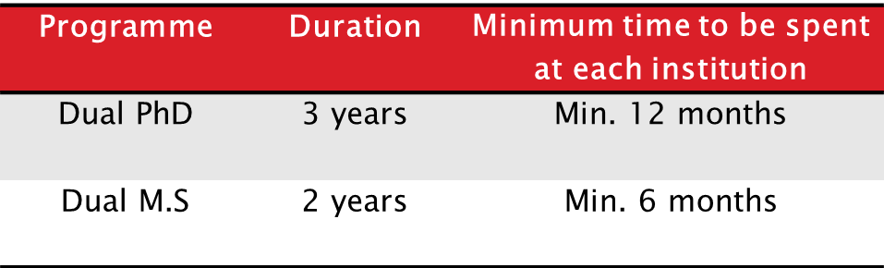
SYARAT KEMASUKAN | Master: Ijazah Bachelor PhD: Master or 1st Class Bachelor (CGPA: >3.75)
BAHASA INGGERIS | Band 6.0 or 6.5 for IELTS (minimum 5.5 or 6.0 for each component) or equivalent
RESIDENTIAL REQUIREMENTS

Slide 25
PROGRAM SISWAZAH TANPA IJAZAH (NON-GRADUATING PROGRAMME)
2 Kategori :
a. Inbound Research Attachment
b. Inbound Mobility (Kursus, Lawatan Jangka Pendek, Internship)
Yuran: RM450.00/semester (Perpustakaan, perubatan, pekhidmatan lain) + Bench Fees (ditentukan oleh fakulti/institut)
Lawatan Jangka Pendek, TIADA YURAN dikenakan
Maklumat Lanjut: http://www.sgs.upm.edu.my/sp/page/2658/IRANG_sps C

Slide 26
Bantuan Kewangan Menghadiri Seminar | Pelajar PhD sahaja Nilai bantuan maksimum RM1500 Permohonan dikemukakan sekurang-kurangnya 3 bulan sebelum tarikh seminar Status pengajian baik Hantar borang GS-46 kepada SPS
Bantuan Kewangan Sangkutan Penyelidikan | Pelajar tempatan (MS dan PhD) sahaja Nilai bantuan maksimum RM4000 Status pengajian baik Hantar borang GS-42 kepada SPS

Slide 27
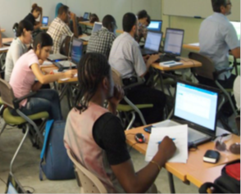
Putra Sarjana (PS)
A learning support programme designed to help graduate students develop a wide range of necessary skills for their academic and research development as well as for their subsequent careers.

Slide 28
Putra Sarjana (PS)
All PS courses are open to all UPM Postgraduates
Places are limited and subjected to availability
Please take note that PS courses are intended solely for academic development, thus it does not count towards the fulfillment of credit requirements

Slide 29

Putra Sarjana (PS)
PS courses address four clusters:
Academic Development
Ethics And Moral
Professional Development
Community Service
(For Editorial Service help by
CALC)

Slide 30
Putra Sarjana (PS)
Students can choose from standalone core courses which covers the following themes:
Studying at UPM
Basic Research Skills
IT and Data Analysis Skills
Research Skills for Sciences/Social Sciences
Thesis Preparation Skills
Personal Development and Community Service
List and synopsis of courses may be viewed in the Putra Sarjana section at the SGS website (http://www.sgs.upm.edu.my/)

Slide 31

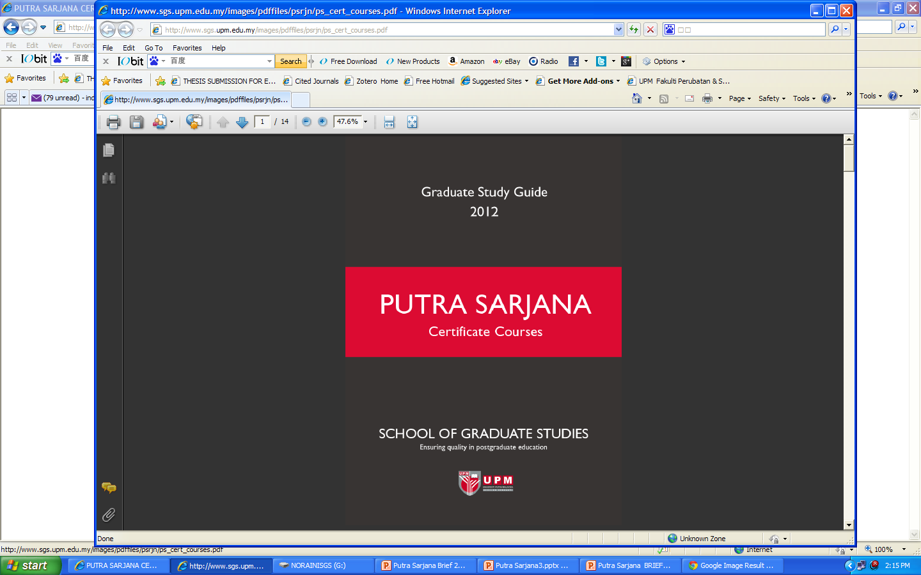
Certificate Courses
PS offers four certificate course packages from selected relevant core courses since the beginning of 2012.
Academic Career Preparatory Certificate I,
Academic Career Preparatory Certificate II,
Write Right© Academic Writing Certificate, &
Professional Skills Certificate.
Certificates of achievement will be awarded upon completion of all the courses in any of the certificate packages.

Slide 32


спасибо
شكرا
آپ کا شکریہ
Salamat
धन्यवाद
谢谢
Ahsante
ありがとう
Terima Kasih
감사합니다
நன்றி
tōmākē dhan'yabāda
مرسی
Thank You
ขอขอบคุณคุณ
Danke
teşekkür ederim
Gracias

